Slide 1

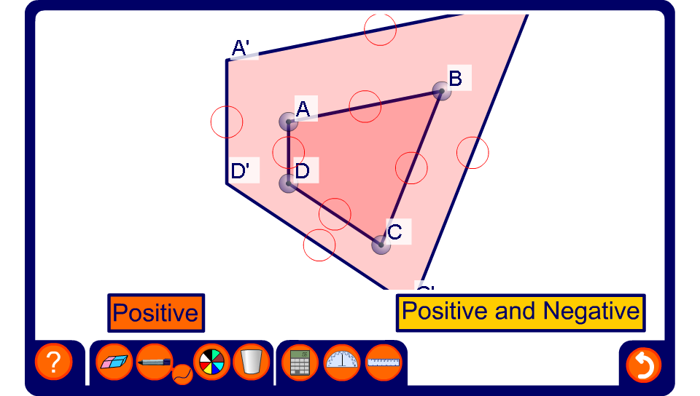


Describing enlargements
Notes:
Modify the shapes as required.
Demonstrate how to find the centre of enlargement using the straight line tool to join points in the image to corresponding points in the enlargement.
Find the scale factor for the enlargement by comparing the lengths of corresponding sides.

